Slide 1
BACKEND DEVELOPER
S. MADHAN KUMAR B.E CSE (2021-2025) JEPPIAAR ENGINEERING COLLEGE

Slide 2
Contents
PRIMARY TOPICS:
SECONDARY TOPICS:
WebSocket → Real-time communication
Node.js → Event-driven architecture,Express.js routing & middleware
RESTful APIs → HTTP methods, status codes, pagination, versioning
Authentication & Authorization → JWT,OAuth2
Testing APIs → Postman, Jest, Super test
Database Design → SQL vs NoSQL, indexing
Cloud Basics → Deploy APIs using AWS Lambda / Azure Functions
System Design → Stateless APIs, scalability, caching
LLM API Usage & RAG → Integrating
APIs with AI-powered workflows

Slide 3
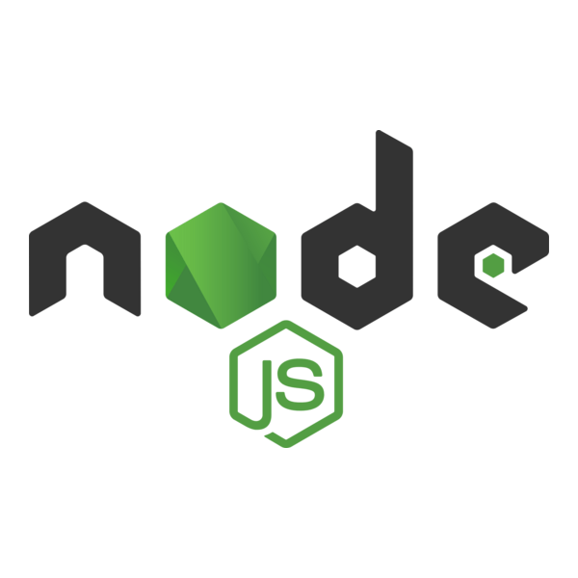
HTML
Node.js is an open-source, cross-platform JavaScript runtime environment.
It allows executing JavaScript on the server-side.
Key Features:
Event-driven architecture: Handles multiple requests efficiently using non-blocking I/O.
Single-threaded, non-blocking I/O: Optimized for high-performance applications.
Built on V8 engine: Fast execution of JavaScript code.
npm (Node Package Manager): Rich ecosystem of modules and libraries.
Use Cases:
Web servers & APIs
Real-time applications (chat, gaming)
Microservices & serverless applications

Slide 4
Event-driven Architecture
Architecture where program flow is determined by events (user actions, messages, etc.)
Node.js uses the Event Loop for asynchronous, non-blocking execution
Components:
Event Emitter: Emits events
Event Listener: Responds to events
Benefits: Efficient concurrency, high performance, scalable for real-time apps

Slide 5
Express.js
Web application framework for building web servers and APIs.
Built on top of Node.js.
Provides features like routing, middleware, and templating.
const express = require('express');
const app = express();
app.listen(3000, () => console.log("Server running on port 3000"));

Slide 6
Routing and Middleware
Routing
Routing refers to how an application’s endpoints (URIs) respond to client requests.
Defines the path and HTTP method (GET, POST, PUT, DELETE).
MiddleWare
Functions that execute between request and response.
Can modify req and res objects.
Used for logging, authentication, data parsing, error handling.
Flow -
Request → Middleware → Route Handler → Response
app.get('/user/:id', (req, res) => {
res.send(`User ID: ${req.params.id}`);
});

Slide 7
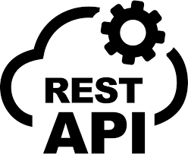
RESTful APIs
REST (Representational State Transfer) → Standard for designing APIs.
Uses HTTP to perform operations on resources.
Ensures scalability, simplicity, and consistent communication between client & server

Slide 8
HTTP Methods in REST
Methods
GET
POST
PUT
PATCH
DELETE
Fetch resources
Add new resource
Replace entire resource
Update part of resource
Remove resource

Slide 9
HTTP Status Codes
Category | Code | Meaning | Description
Success | 200 | OK | Request successful
Success | 201 | Created | New resource created
Client Error | 400 | Bad Request | Invalid input
Client Error | 401 | Unauthorized | Auth required
Client Error | 404 | Not Found | Resource missing
Server Error | 500 | Internal Server Error | Unexpected issue

Slide 10
Pagination and Versioning
Pagination helps limit the number of records returned per request.
Improves performance and reduces load.
Typically implemented using query parameters
Response Example
Versioning allows updates without breaking existing client integrations
Common approaches:
URI Versioning: /api/v1/users
Header Versioning: Accept: application/vnd.company.v1+json
Query Parameter: /users?version=1
GET /api/v1/users?page=2&limit=10
{
"page": 2,
"limit": 10,
"totalPages": 5,
"data": [ ... ]
}

Slide 11
Authentication vs Authorization
Authentication verifies a user’s identity (e.g., login with email and password).
Authorization determines what that user can access (e.g., admin privileges).
Example: A user may be authenticated but not authorized to delete data.
Together, they form the foundation of API security and access control.

Slide 12
JSON Web Tokens (JWT)
JWT is a compact, URL-safe token used for stateless authentication.
It has three parts: Header, Payload, and Signature.
Flow:
User logs in → Server validates credentials
Server generates JWT → Sends to client
Client stores token (in localStorage / cookie)
Client includes JWT in Authorization header → Bearer <token>
Server verifies token → Grants access

Slide 13
OAuth 2.0
OAuth2 allows third-party apps to access user data without sharing passwords
Commonly used by Google, Facebook, GitHub logins
Uses access tokens and refresh tokens
Key Roles:
Resource Owner – The user
Client Application – The app requesting access
Authorization Server – Issues tokens
Resource Server – Hosts protected data
Authorization Flow:
User grants permission to the app
Authorization server issues token
App uses the token to access protected resources

Slide 14
API Testing
Functional Testing:
Checks if API functions work correctly
Integration Testing:
Tests communication between services
Performance Testing:
Checks API responsiveness under load
Security Testing:
Validates authentication, authorization, and data protection

Slide 15

Testing with Postman
Postman is a GUI-based API testing tool that simplifies sending HTTP requests and inspecting responses.
Features include:
Organizing API requests into collections.
Using environment variables for dynamic testing.
Running automated test suitesPostman helps developers debug APIs and document endpoints effectively

Slide 16
Testing with Jest & Supertest
Jest:
JavaScript testing framework
Runs unit and integration tests
Supports mocks and snapshots
Supertest:
Works with Jest for API testing
Sends HTTP requests to server endpoints
Validates responses programmatically
Advantages:
Fully automated testing
Integrated into CI/CD pipelines
Repeatable and scalable

Slide 17
Introduction to WebSocket
WebSocket provides full-duplex communication between client and server over a single TCP connection.
Unlike HTTP, WebSocket allows the server to push data to the client in real time. It’s ideal for use cases like chat systems, live score updates, and stock tickers.
Low latency and persistent connection. In Node.js, WebSocket can be implemented using libraries like Socket.io.
io.on('connection', socket => {
console.log('User connected');
socket.emit('welcome', 'Hello client!');
});

Slide 18
SQL vs NoSQL Databases
SQL (Structured Query Language) databases like MySQL and PostgreSQL store data in structured tables with predefined schemas.
NoSQL databases like MongoDB and Cassandra are schema-less, storing data as JSON or key-value pairs.
SQL is best for complex relationships; NoSQL suits flexible, scalable systems like real-time analytics or content management.

Slide 19
Indexing Databases
Indexing improves query performance by reducing search time.
Works like an index in a book → helps locate data without scanning the entire table.
Tradeoff: indexes require additional storage and slower writes.
Types of Indexes-
Single-column index – Based on one column
Composite index – Based on multiple columns
Unique index – Ensures unique values in a column
Full-text index – Optimizes text searching

Slide 20
Cloud Basics – Deploying APIs
Cloud computing allows developers to host and deploy applications without managing physical servers.
It provides computing resources such as storage, networking, and databases over the internet.
Deployment Types ->
IaaS (Infrastructure as a Service): Virtual machines, storage, networks.
PaaS (Platform as a Service): Runtime environments, APIs, developer tools.
FaaS (Function as a Service): Serverless execution for backend functions.

Slide 21
Deploy APIs using AWS Lambda
AWS Lambda: Event-driven serverless compute service
Runs code in response to events (HTTP requests, database changes, file uploads).
Works with API Gateway to deploy RESTful APIs.
Create Lambda function in AWS Console
Write API logic in Node.js, Python, etc.
Set up API Gateway to route HTTP requests to Lambda
Deploy API
Test endpoint

Slide 22
Deploy APIs using Azure Functions
Create an Azure Function App
Choose runtime (Node.js, Python, C#, etc.)
Write function logic
Bind function to HTTP trigger
Deploy & test
Azure Functions: Microsoft’s serverless compute service.
Responds to HTTP requests or triggers (timers, queues, databases).
Easily integrates with Azure API Management for APIs

Slide 23
Stateless APIs
Stateless API: Does not store client context.
Reduces Memory usage.
Improves scalability, reliability and reduces complexity.
Stateless APIs do not store any session information on the server. Advantages:
Easier to scale horizontally
Reduces memory usage
Simplifies load balancing

Slide 24
Saleability in System Design
Scalability is the ability of a system to handle increased load.
Types –
Vertical scaling: Adding resources (CPU/RAM) to a single server.
Horizontal scaling: Adding more servers or instances.
Load balancers distribute traffic efficiently, while micro services allow independent scaling of components.

Slide 25
Caching
Caching: Storing frequently accessed data for faster retrieval
Reduces server load and improves response time
Types of Caching:
Client-side caching (browser cache)
Server-side caching (in-memory store)
Distributed caching (shared cache across servers)
Example Technologies:
Redis, Memcached (server-side caching)
CDN (Content Delivery Network) for static assets

Slide 26

LLM API Usage Overview
LLM (Large Language Model) APIs allow developers to access powerful AI models like GPT, Claude, or Gemini through cloud endpoints.
These APIs enable apps to perform natural language understanding, text generation, summarization, or reasoning without hosting the model locally.
Common LLM Providers:
OpenAI API (GPT models)
Anthropic Claude API
Google Gemini API
Azure OpenAI Service
const response = await openai.chat.completions.create({
model: "gpt-4",
messages: [{ role: "user", content: "Summarize this document." }]
});
console.log(response.choices[0].message.content);

Slide 27
Retrieval-Augmented Generation (RAG)
RAG combines LLMs with external data sources for context-aware responses. RAG Workflow:
User Query → Input request
Retriever → Fetches relevant documents from a database/vector store
Augmentation → Adds retrieved data to the prompt
Generation → LLM produces an informed, updated response

Slide 28
Integrating APIs with AI Workflows
LLM APIs and RAG pipelines can be combined in workflows for intelligent automation.
Enables dynamic responses using real-time data and custom knowledge sources.
User Query
API Gateway
Retriever (Vector DB)
LLM API → Response

Slide 29
Practical Integration Steps:
Collect & pre-process data → store in vector DB
Embed documents using LLM embedding's API
Implement retriever
logic to find relevant context
Send context +
query to LLM API for generation
Return output
via REST API or chatbot interface
Benefits:
Contextual and factual responses
Scalable, modular architecture
Works across chatbots, search engines, and analytics tools

Slide 30
THANK YOU

